Slide 1

Introducing
A step-by-step guide to basic experiment review using Hawkeye software

Slide 2

About this Guide
This guide will…
document the steps necessary to install and set up Hawkeye on your computer
walk you through creating a new project (using the QuickStart Wizard) and opening an existing project
show you how to view and score crystallization experiments
look at several ways to save your projects and export results for use outside of Hawkeye

Slide 3
About this Guide
What you will find in this guide:
Step-by-step instructions
Lots of screenshots and illustrations
Brief descriptions of certain features
What you will not* find in this guide:
Detailed explanations of features
Advanced capabilities of the software
Technical information or specifications
Assistance for Linux users
Troubleshooting tips

Slide 4
Installing Java
Because Hawkeye is a Java-based program, you will need to have Java installed on your computer before you can run it.
For Windows, download and install the latest JRE from https://java.com/en/download/manual.jsp.
For Mac, download and install the latest JDK from http://www.oracle.com/technetwork/java/javase/downloads/index.html.

Slide 5
Acquiring Hawkeye
(Info pending…)
Download
Install

Slide 6
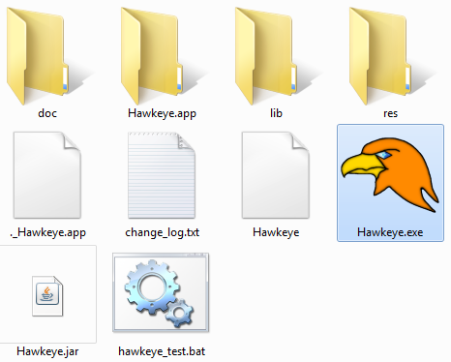
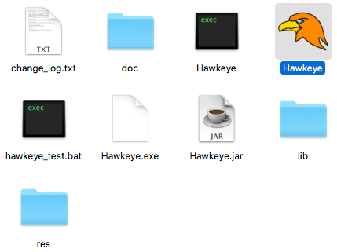
Running Hawkeye
On Windows, double-click the Hawkeye.exe file (the file with the distinctive Hawkeye icon).
On Mac, double-click the Hawkeye application package (the file with the distinctive Hawkeye icon).
Run Hawkeye on Windows by opening the ‘Hawkeye.exe’ file.
Run Hawkeye on Mac by opening the ‘Hawkeye’ file.

Slide 7
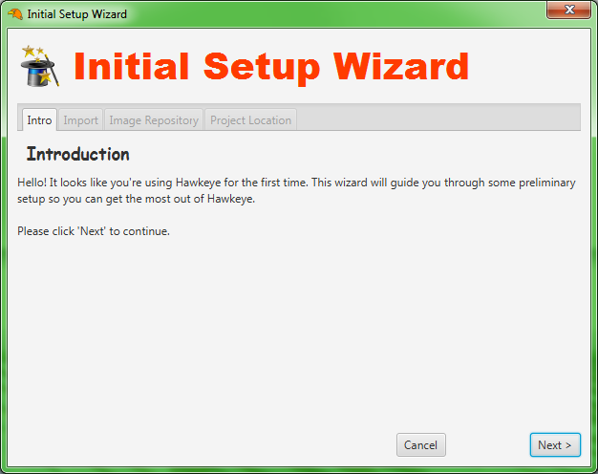
Initial Setup Wizard
When a copy of Hawkeye is launched for the first time, the user will see a setup wizard. There are 3 steps:
Import from distribution
Choose image repository
Choose default project location
Initial Setup Wizard is shown when Hawkeye is launched for the first time.

Slide 8
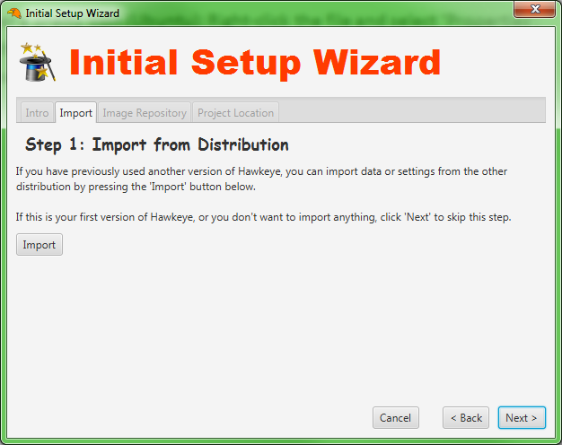
Import from Distribution
If you want to import data and/or settings from another Hawkeye distribution (such as an earlier version), you can do so at this step.
Just click the ‘Import’ button and select the folder of the other distribution from which you want to import. You can then choose whether to import data, settings, or both.
If you are using Hawkeye for the first time (or don’t want to import anything), just click ‘Next’ to skip this step.
The user has the option to import data and/or settings from another distribution. Use this option if you want to keep existing work when you upgrade to a newer version of Hawkeye.

Slide 9
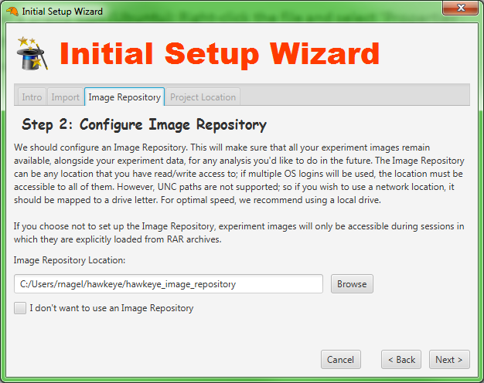
Choose Image Repository
Next, the user should choose an Image Repository location. The Image Repository is just a folder on your disk designated as a storage place for images used by Hawkeye. All images extracted from RAR archives will be placed there, and remain available for future use. Here are some guidelines for choosing a repository location:
Make sure the repository location has plenty of disk space. The repository stores all your images over time; and images from a single RAR can exceed 150MB.
If multiple users will login to the OS and use Hawkeye, make sure the chosen path is accessible to all users.
UNC paths (“\\path”) are not supported; so if you wish to use a network path, first map it to a drive letter.
The user can choose an Image Repository for storing the images used by Hawkeye.

Slide 10
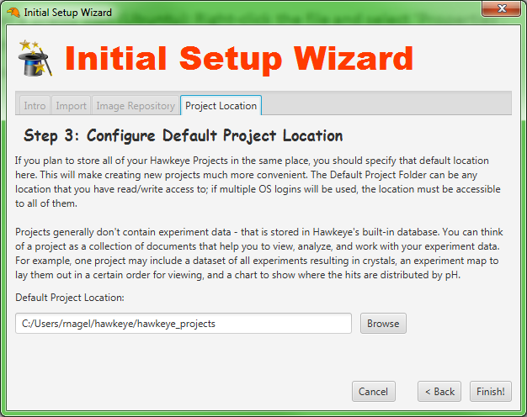
Choose Default Project Location
Finally, the user must choose a default project location. This is a folder on disk where new projects will be placed by default. The same rules apply to this folder as to the Image Repository folder:
If multiple users will login to the OS and use Hawkeye, make sure the chosen path is accessible to all users.
UNC paths (“\\path”) are not supported; so if you wish to use a network path, first map it to a drive letter.
After finishing the wizard, the user will see a Login window.
The user must choose a folder where new projects will be placed by default.

Slide 11
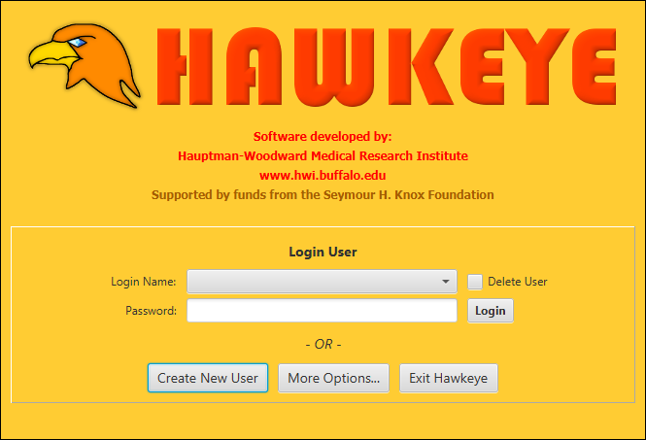
Login/Splash Window
Before using Hawkeye, a user must be created and logged in. On the Login/Splash window, click ‘Create New User’ and fill in the following fields:
First & Last Name
Association (can be your lab, office, or organization name; associates should use the same text for this field)
Password
When the new user has been created, select the user from the Login Name dropdown and enter the password. Click ‘Login’ or press [Enter] to login.
Create and login users through the Login/Splash window.

Slide 12
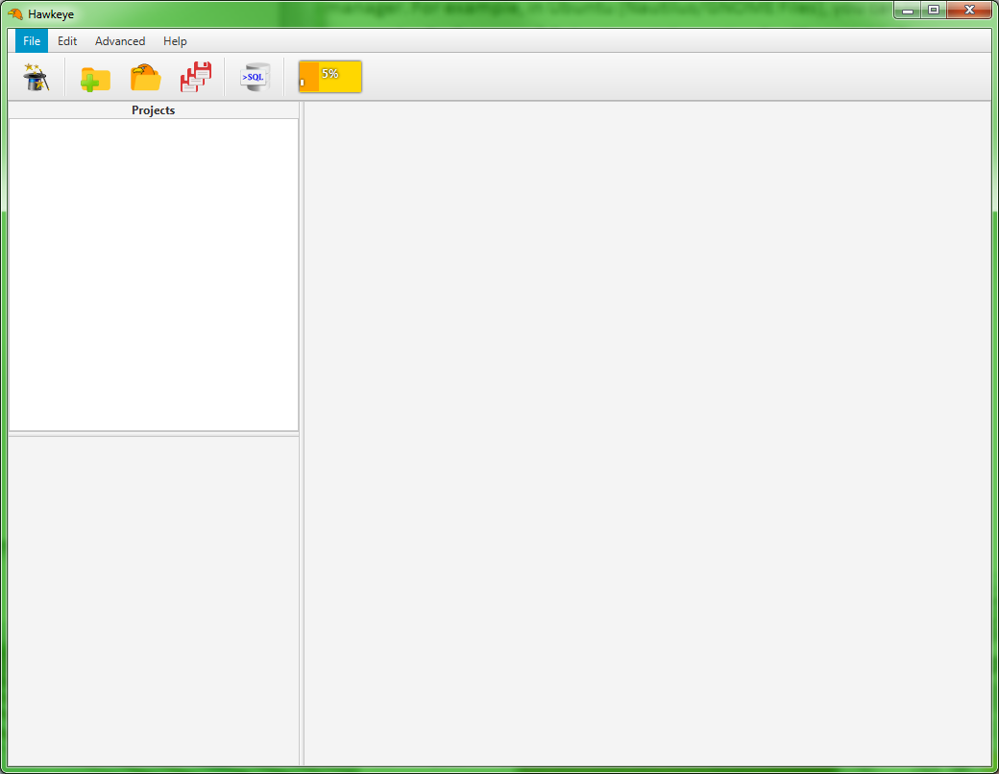
Main Interface
Many program commands can be found here.
Shortcuts to the most common commands are shown here.
Memory usage is tracked here.
Open projects, and the features they contain, will be listed here.
Open features and other documents will be shown here as tabs.
Information about the selected feature or document is displayed here.
Hawkeye Main Interface at startup.

Slide 13
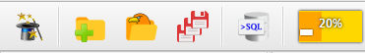
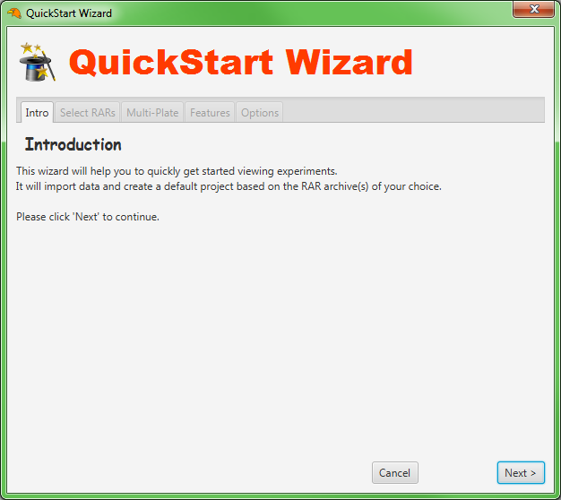
Use the QuickStart Wizard
QuickStart Wizard
New Project
Open Project
Save All Projects
Database Terminal
Memory Monitor
The Main Tool Bar contains shortcuts to some common program commands.
We want to use the QuickStart Wizard, so we’ll click the first button in the tool bar—the one that looks like a magic hat.
The QuickStart Wizard will automatically create a new project with default features based on the RAR archives that you choose. Click ‘Next’ to begin the wizard.
The QuickStart Wizard.

Slide 14
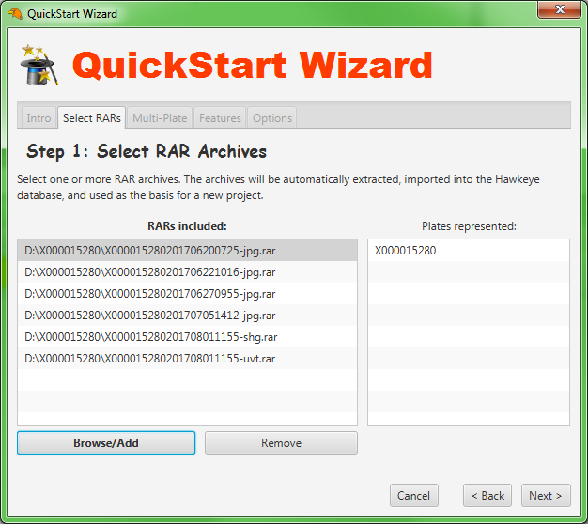
QuickStart Wizard: Step 1
In Step 1 of the QuickStart Wizard, we choose the RAR archives to be used as the basis for our new project.
Each RAR contains images for one read of a particular plate. We want to make a project to represent a plate of experiments, so we choose only RARs that belong to the same plate.
To add RARs, click the ‘Browse/Add’ button. A file browser will appear. Navigate to where your RAR files are stored, and select one or more files. To open multiple files, use the [Ctrl] or [Shift] keys. Click ‘Next’ when you are done with this step.
Creating a project for plate “X000015280”, we select RARs beginning with the same plate name. Each RAR will add an additional image of each experiment in the plate. RARs with the endings “-shg.rar” and “-uvt.rar” contain second harmonic generation and ultraviolet images, respectively.

Slide 15
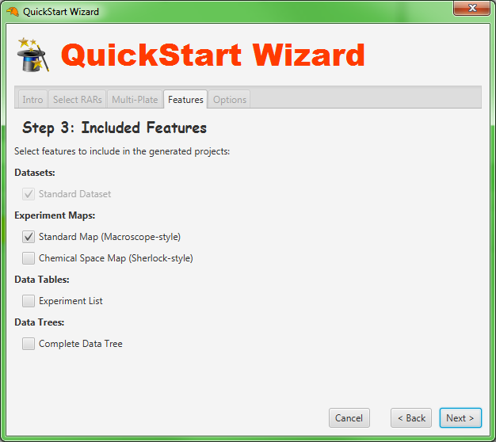
QuickStart Wizard: Step 3
In Step 3 of the QuickStart Wizard, we select which features we want to include in our new project.
Since we are interested in reviewing experiments visually, we will just leave the box checked for the “Standard” experiment map, which will lay out experiments in a way similar to our old Macroscope programs. Click ‘Next’ again.
(The dataset is checked by default and cannot be unchecked, because it is required by the project.)
Select the “Standard” Experiment Map to view a visual arrangement of experiments sorted by well position or cocktail number.

Slide 16
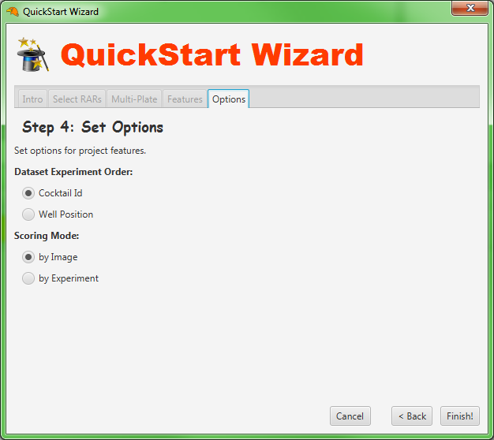
QuickStart Wizard: Step 4
In Step 4, we can set some options for the project.
For Dataset Experiment Order, you can choose to sort experiments by either cocktail ID or well position. Choose whichever you like.
The Scoring Mode determines whether scores will be applied to entire experiments, or to individual images. When scoring by image, the user looks at each image and assigns score(s) to describe the image. When scoring by experiment, the user looks at all images of the experiment collectively, and assigns score(s) to describe the result of the experiment as a whole. For simplicity, this guide will focus on Scoring by Image.
This is the final step; click ‘Finish’ to complete the wizard.
Some options can be set to customize the new project. In our case, the user can choose the order for experiments and the scoring mode. The defaults are to view experiments in order of Cocktail ID, and apply scores by image.

Slide 17
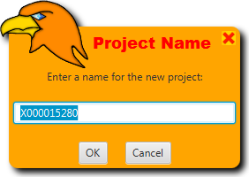
Name the Project
With all necessary steps complete, the QuickStart Wizard is ready to create your new project.
Since all RARs are from the same plate, Hawkeye will cleverly suggest the name of that plate to be the project name. If desired, you can change the name of the project. Click ‘OK’ when you are satisfied with the name of the project.
Choose a name for the new project. By default, if all RARs are reads of the same plate, Hawkeye will suggest naming the project after the plate. You can change the name if you want.

Slide 18
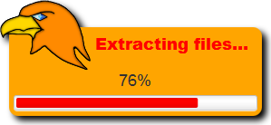
Be Patient!
The QuickStart Wizard needs a little time to complete its work.
Specifically, it has to:
Extract all RAR files
Import experiment and image data
Create the new project and its features
Load and display the first page of images
Depending on the speed of your computer and the number of RAR files being opened, this process can take anywhere from a few seconds to several minutes. Now is a great time to grab a cup of coffee…
While busy with QuickStart operations or other tasks, Hawkeye will display a progress bar to show what it’s doing and how close it is to being done.

Slide 19
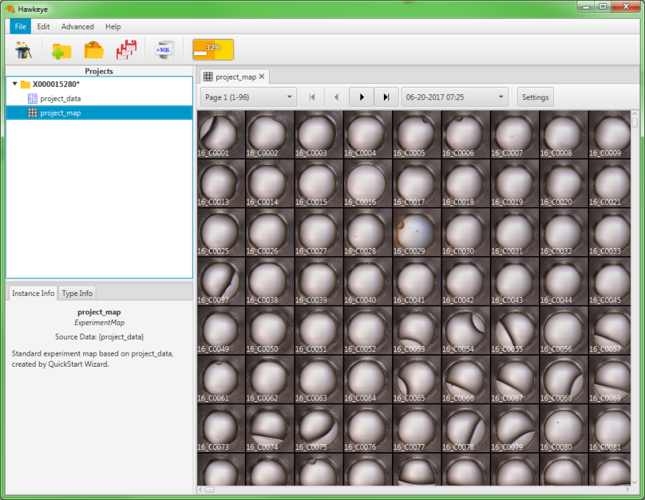
Your New Project
When the QuickStart Wizard has finished, your new project is shown in the Project Explorer and the experiment map feature is displayed in the workspace area.
The new project, “X000015280”, is shown here, with all its features.
The experiment map feature, “project_map”, is opened by default and displayed in the workspace area as a tab.
Some basic information about the current feature is shown here.
Hawkeye Main Interface with the new project shown after completion of the QuickStart Wizard.

Slide 20
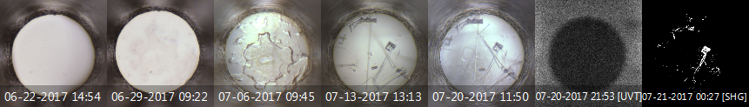
What is an Experiment?
Before we look at the experiment map, it is important to clarify what we mean by an “experiment”. In our terms, an experiment is defined as:
1 protein sample + 1 cocktail inside 1 well of a particular plate over a set time (other conditions or variables may apply).
In Hawkeye, you will sometimes see an experiment identified by a unique combination of its plate name and position within the plate (well position); this is the experiment ID. For example:
X000015280.0001
Over time, the plate is imaged (read) several times, resulting in several images of each experiment.
Five standard images taken at different time points, along with ultraviolet (UVT) and second harmonic generation (SHG) images, of a crystal-producing experiment.

Slide 21
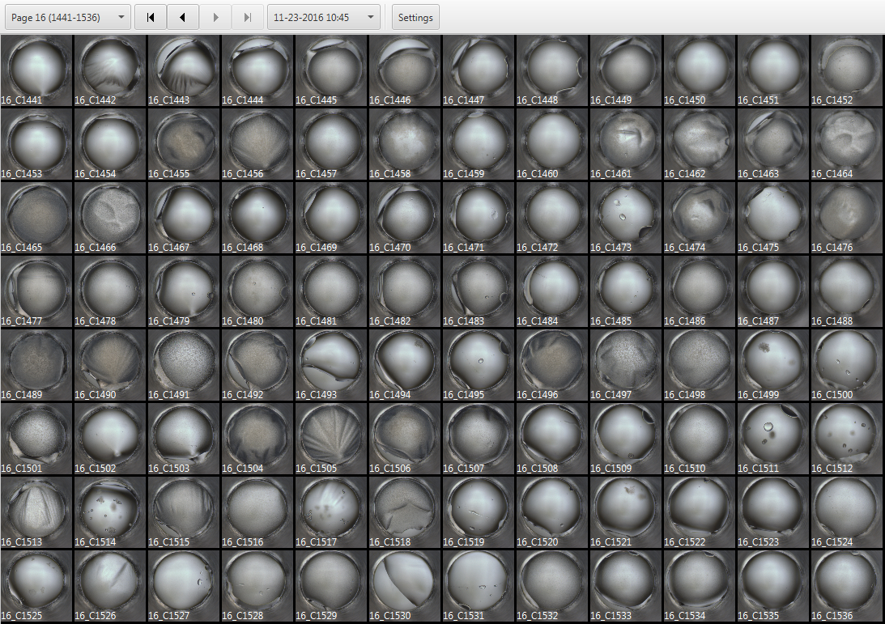
The Experiment Map
An experiment map is a visual arrangement of cells, in which each cell represents an experiment.
An experiment map. By default, maps created by the QuickStart Wizard contain 96 cells per page (12 × 8)—the same layout used by the earlier Macroscope programs.

Slide 22
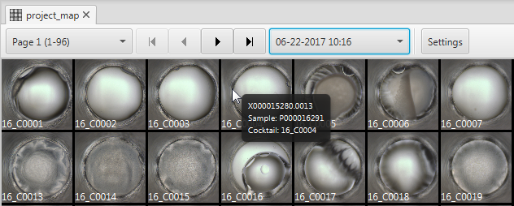
Experiment Map Controls
At the top of the experiment map are controls for changing the current page, as well as selecting the index of the images to display for each experiment.
Use the page selector to select any page of experiments. Since this map has pages of 96 experiments, the first page contains the 1st - 96th experiments in the dataset.
Select the current read index (image) to display for all experiments.
First page
Next page
Previous page
Last page
Additional Settings
Controls appear at the top of each experiment map.

Slide 23
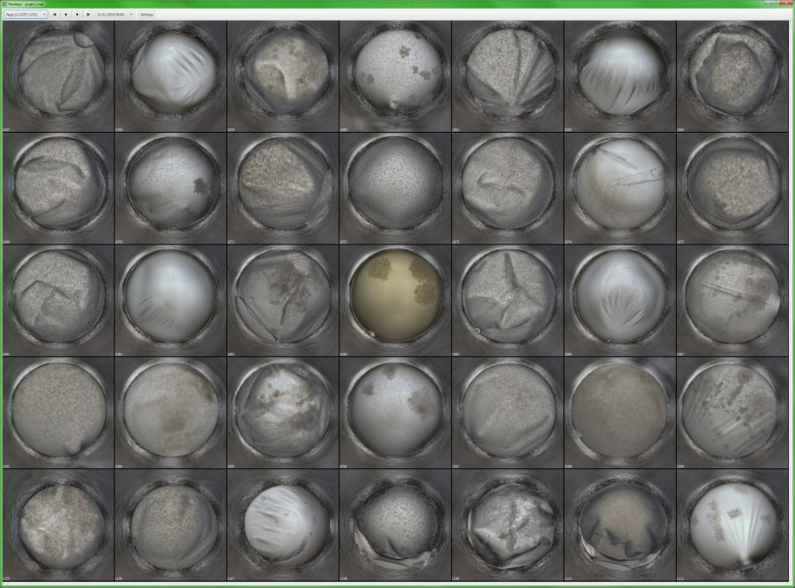
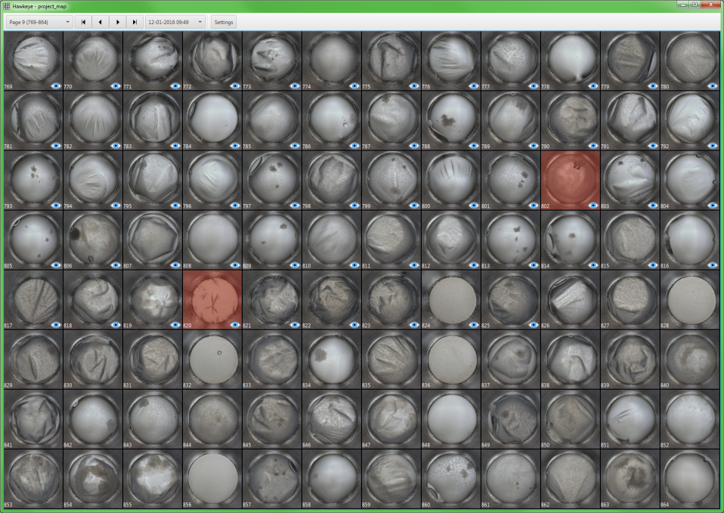
Using the Map
The experiment map can be used to quickly look over many experiments at a time: either to scan for crystals, or to see what has been viewed, scored, or selected already.
Some crystals, such as the ones circled here, can be spotted when looking at a page of experiment images—especially on a high-resolution screen. The cells can be zoomed in and out using the mouse wheel.
Once full analysis is complete, however, images already scored as crystals can be easily found by their color-coded shading. The “eye” icon in the lower-right corner of some cells indicates that they have been individually inspected at full size.

Slide 24
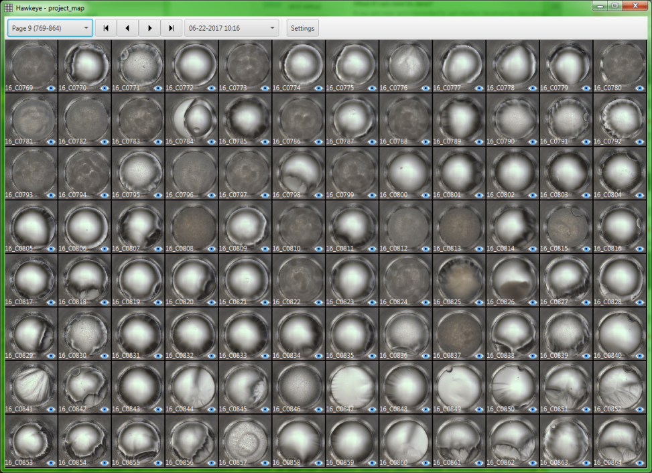
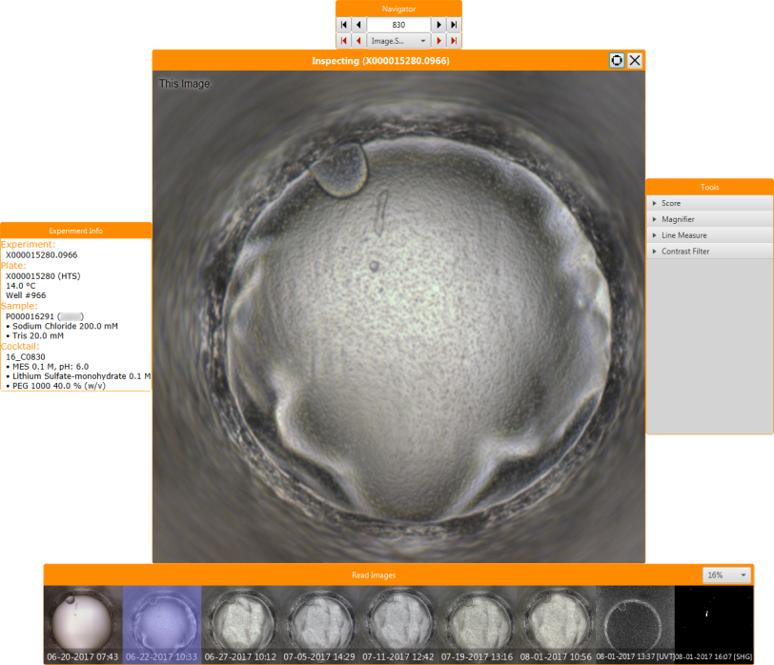

Inspecting Individual Experiments
Click any cell in the experiment map to open an Inspector window, which is used for reviewing and scoring individual experiments one at a time. (If you want to review all experiments in order, click the first cell on Page 1.)
Left-click any cell in an experiment map to show that experiment in a new Inspector window. The Inspector displays all images of the experiment, along with a summary of the associated condition data. The user can navigate forward or backward through the dataset to review all experiments sequentially.

Slide 25
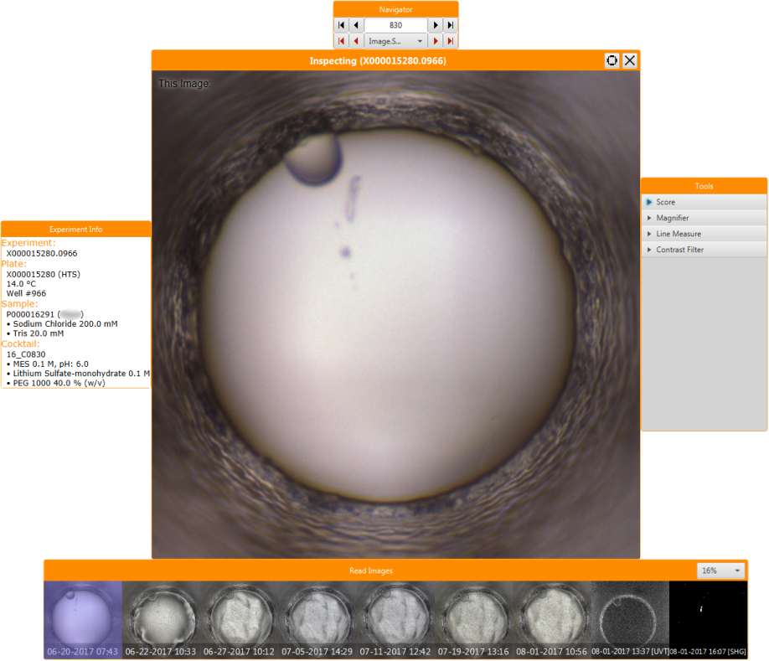
The Inspector
The Inspector consists of a Main panel (which displays the indexed image of the current experiment) surrounded by 4 auxiliary panels.
The Navigator panel contains controls for navigating to other experiments in the dataset.
The Main panel displays the indexed image of the current experiment at full size.
The Tools panel contains tools to assist with reviewing experiment images.
The Experiment Info panel displays a summary of the current experiment’s condition data.
The Read Images panel displays all time point images for the current experiment.
The Inspector consists of a Main panel and 4 auxiliary panels. Panels can dragged with the mouse to reposition them. Moving an auxiliary panel close to an edge of the Main panel will make it “snap” to that edge. Moving the Main panel will also move all auxiliary panels.

Slide 26
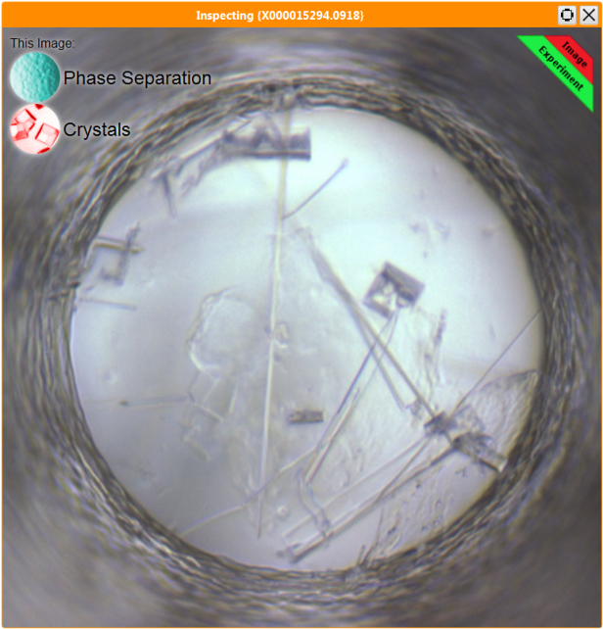
Inspector: Main Panel
The Main panel displays the indexed image of the current experiment at full size.
This button resets the 4 auxiliary panels to their default positions.
The Main panel’s title bar shows the ID (plate + well position) of the current experiment.
This button closes the Inspector, including all auxiliary panels.
Applied scores are indicated in the top-left corner.
Selection of the current image or experiment is indicated in the top-right corner.
The Main panel of the Inspector displays the indexed experiment image, and may also contain score or selection indicators.

Slide 27
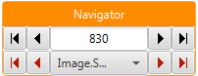
Inspector: Navigator Panel
The Navigator panel contains controls for navigating to other experiments in the dataset. The black arrows on the top row are for navigating to the first, previous, next, and last experiments in the dataset. The red arrows on the bottom row are for navigating to the first, previous, next, and last experiments in the dataset that match the specified condition.
The index of the current experiment within the dataset/map. Note that this number does not represent a well position or cocktail ID; however, it may correspond to the well position if the dataset is ordered by well position, or the cocktail ID if the dataset is ordered by cocktail ID (check the Experiment Info panel to be sure). You can type a new index in the box to jump to any experiment in the dataset.
Previous experiment
Next experiment
First experiment
Last experiment
First experiment that matches the condition
First experiment that matches the condition
Previous experiment that matches the condition
Specify a condition:
selected images
selected experiments
an image score
an experiment score
Previous experiment that matches the condition

Slide 28
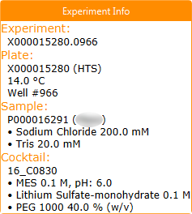
Inspector: Experiment Info Panel
The Experiment Info panel displays a summary* of condition data for the current experiment. The summary includes both chemical ingredients and identifying information.
Experiment ID
Plate ID
Temperature
Well Position
Sample ID
Sample Buffer Ingredients
Cocktail ID
Cocktail Ingredients

Slide 29
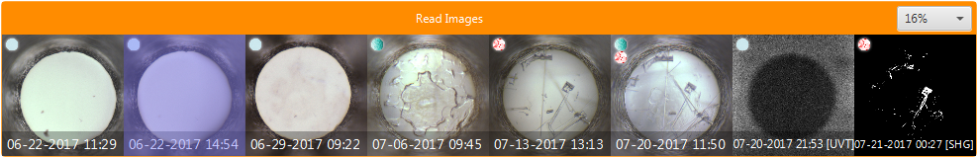
Inspector: Read Images Panel
The Read Images panel displays all images of an experiment with their respective timestamps. The user can click any image to view it at full size in the Main panel and score it.
Icons indicate image scores, as in the Main panel
Select size of the images
The current image is highlighted in blue
Ultraviolet and second harmonic generation images
A timestamp on each image shows the time of imaging in 24-hour time

Slide 30
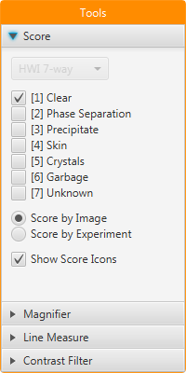
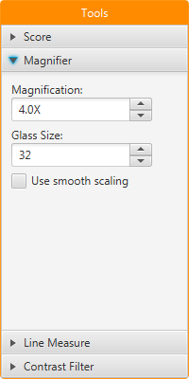
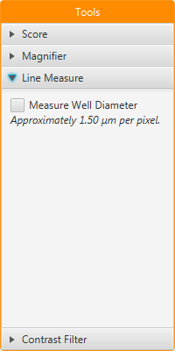
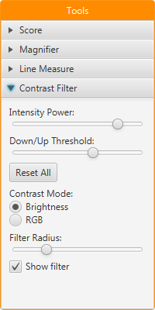
Inspector: Tools Panel
The Tools panel contains an assortment of tools that can be useful for reviewing experiment images. Clicking any tool will activate it and allow the user to adjust its parameters. (More tools may be added in future versions.)
The Score tool shows a listing of available scores and allows toggling them with the mouse. It also allows changing the current score mode.
The Magnifier tool places a magnifying glass simulation at the mouse cursor, making it easier to examine tiny features (especially on a high-resolution screen).
The Line Measure tool allows the user to take linear measurements on the image in pixels and microns (estimated).
The Contrast Filter tool places a moveable filter on the image that increases the contrast of image colors, making it easier to examine barely-visible image objects.
For detailed information and tips about these tools, see the User Manual.

Slide 31
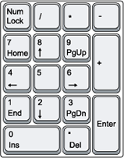
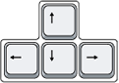
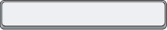
Using Keyboard Controls
Experiment review can be performed with the mouse, but is much more efficient when using keyboard shortcuts instead. There are keys for navigation, scoring, and selection.
Make sure Num Lock stays ON while scoring, or the keypad numbers will be interpreted as arrow keys and perform navigation functions instead!
The keypad numbers can be used to score the current image or experiment (depending on the score mode).
The left & right arrow keys advance to the previous or next experiment in the dataset.
The spacebar toggles selection on the current image or experiment (depending on the score mode).
The up & down arrow keys change the image index.
The Enter key advances to the next experiment (same as right arrow key), allowing both forward navigation and scoring without moving the hand from the keypad.

Slide 32
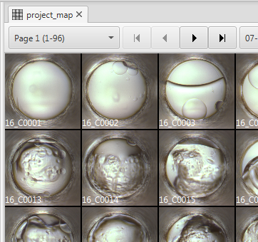
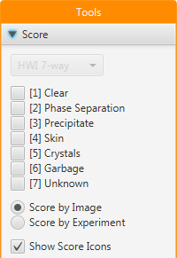

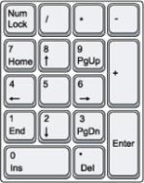
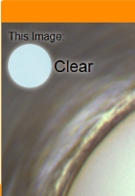

Image Scoring Procedure
Assuming you chose to Score by Image (default) in the QuickStart Wizard, follow this procedure to review and score individual images.
1. Open an Inspector by clicking on the first cell in the experiment map. |  | 2. Open the Score tool in the Tools panel. You will see a list showing which number key will apply which score.
3. Use the keypad numbers to toggle one or more scores for the current image. (Make sure Num Lock is ON.) |  | 4. When you have scored the current image, press the Enter key to move to the next experiment.

Slide 33
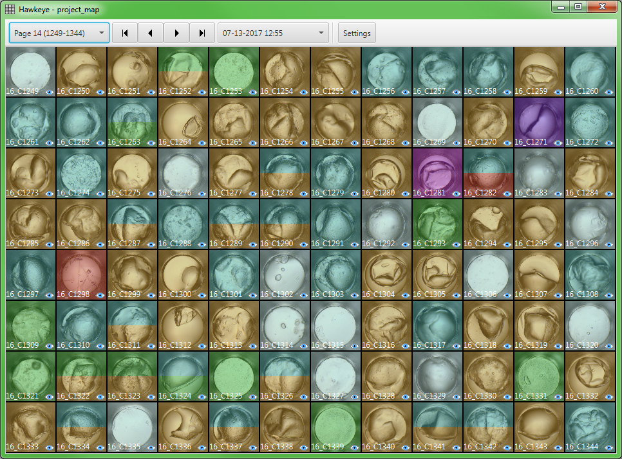
Reviewing Scored Images
When image scoring is complete, images shown in the experiment map will be color-coded by score(s). The shading is the same color as the score icons in the Inspector window. If multiple colors are shown in a cell, the displayed image has been given multiple scores.
A page of experiments after scoring by image. Images with more than one score are shown with multiple colors.

Slide 34
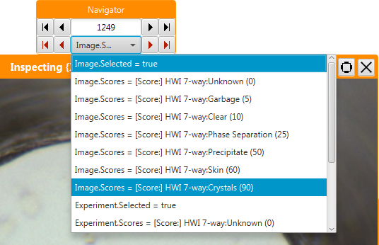

Searching for Scored Images
To search for images with a particular score, click any cell in the map to open an Inspector window.
In the Navigator panel, set the condition drop-down to the score you want to look for.
Use the red arrow buttons to navigate to other images having the score that you specified.

Slide 35
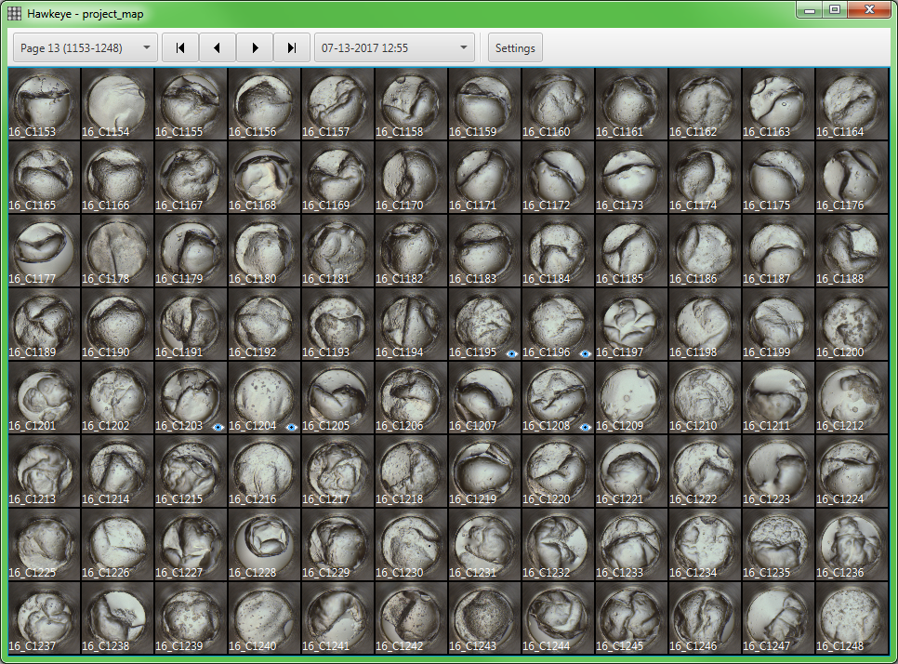
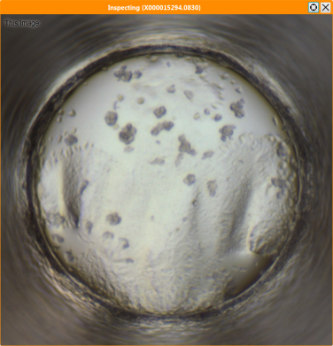
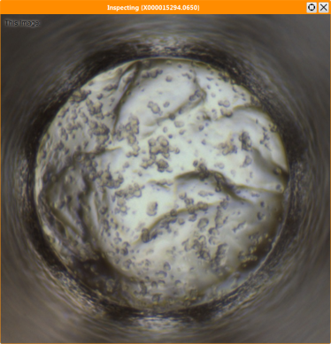
Comparing Images
To compare any images side-by-side, you can click the experiment map more than once to open multiple Inspector windows. Then navigate to the desired image in each Inspector.

Slide 36
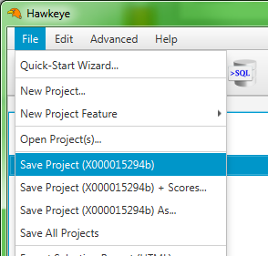
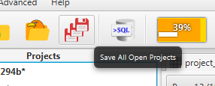
Saving Projects
To save the active project, open the [File] menu and click [Save Project]. The project will be saved in the Default Project Location you specified in the setup wizard.
You can also use the shortcut on the main toolbar to save all open projects. (The icon with 3 red floppy disks.)

Slide 37
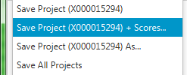
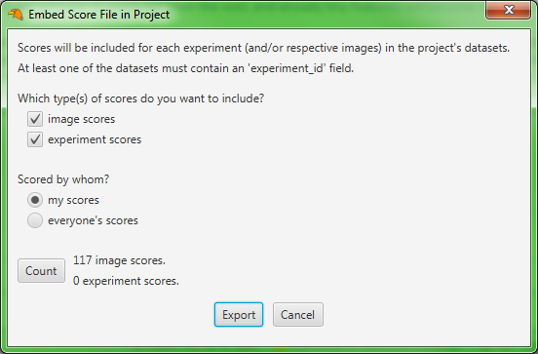
Sharing Results
If you want to share your scores with another Hawkeye user, you can export a score file. When they open the score file, your scores will be imported into their database. The simplest way to do this is to embed the score file in your saved project.
To do this, open the [File] menu and click [Save Project + Scores].
In the resulting dialog, there are some options to choose exactly which scores you want to embed in the project. After choosing your options, click [Count] to see how many scores will be included. Click [Export] to finish.

Slide 38
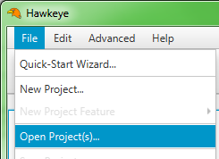
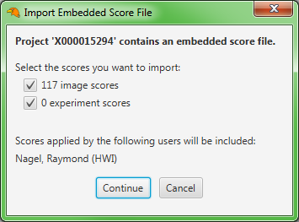

Opening Projects
To open a project that you saved earlier, or a project that was sent to you by someone else, open the [File] menu, click [Open Projects].
If the project contains an embedded score file, you will be asked which (if any) of the included scores you want to import into your database. To import scores, check at least one box and click [Continue]. To open the project without importing any scores, click [Cancel].
The opened project appears in the Project Explorer. To view experiments, you will need to open the experiment map by double-clicking its icon under the project.

Slide 39


Project Dependencies
If the project was created in a different copy of Hawkeye, you may receive a message saying that you are “Missing Required Archives”. This means that the project was created using certain RAR files, and those RAR files must be imported into the database before the project can be opened.
To import the required archives, open the [File] menu and click [Import RAR Archives]; then navigate to where the archives are stored in your filesystem.

Slide 40
Other Exports
Using projects to review results in Hawkeye is recommended, as it allows the user to take advantage of all the tools and features built into Hawkeye.
In some cases, however, you may want to export data into other formats for use outside of Hawkeye. These formats include HTML Selection Reports and MSO files, both of which can be exported from the [File] menu.

Slide 41


Selection Report
A Selection Report displays select experiments in a web page so they can be viewed publicly without the need for Hawkeye software. The report contains images, experiment data, and timestamps. Selected images are shown in red.
A Selection Report as viewed in Mozilla Firefox. Each experiment entry is shown with associated images and data. Images and experiments selected in Hawkeye are shown in red.
Clicking an image in the report opens a new window (or tab) displaying the image at full size with an experiment data summary. Click the image to close the image window.

Slide 42




Making a Selection
To export a Selection Report, you must first make a selection. A selection in Hawkeye is similar to a score, but does not assign a permanent classification. To toggle selection on an image, press the spacebar when reviewing the image in the Inspector window.
From the Inspector window, press the spacebar to toggle selection on the currently displayed image. Image selection is represented by a red banner in the top-right corner of the image.
Once you have selected all images you want to highlight in the report, open the [File] menu and click [Export Selection Report]. This will open a dialog where you can customize the contents of the report.

Slide 43

Exporting the Selection Report
The Export Selection Report dialog allows the user to specify which selected images or experiments will appear in the report, and how they will appear.
For simplicity, let’s assume that you want to create a report of all selected images for one plate. Select the desired plate from the drop-down, and make sure the “selected images” box is checked. Click [Count] to view the total selections that will be included in the report. Click [Export] to create the report.
Aside from specifying which selected images or experiments to include, there are also options for including sample info and using true thumbnails in the report, which may decrease loading time when viewed online—especially if the report is large, or when using a slow internet connection.

Slide 44

Using the Selection Report
The created report exists on disk as a directory containing images and HTML pages. To view the report, open the “index.html” file in your default browser by double-clicking it. (The other files are used by index.html; do not open them directly.)
To include the report on your website, upload the entire directory to your web server and reference the “index.html” file in your HTML code.
Contents of a Selection Report directory. If the report was created with thumbnails, an additional directory called “thumbs” will be created. Open “index.html” to access the report.

Slide 45


Exporting an MSO File
MSO (MacroScope Output) is a file format developed many years ago by HWI to save and transfer image score information. The format is poorly organized and unreliable by today’s standards, and is not recommended for integration in new developments. However, some legacy programs still use the MSO format to import scores.
Hawkeye cannot open MSO files; but it is capable of exporting them for use in other programs. To export an MSO file, open the [File] menu and click [Export MSO File].
An MSO contains scores or selection for 1 plate read. When exporting the MSO, you can choose which read of which plate to export; and whether to include select, your scores, or everyone’s scores. Click [Export] to export the file to disk.

Slide 46
Conclusion
Having completed this guide, you should now have a basic understanding of:
How to set up and start Hawkeye
How to use the QuickStart Wizard to create a new project
How to review and score experiment images
How to save and open projects
How to export score files, selection reports, and MSO files
There is much more that can be done with Hawkeye, but that is beyond the scope of this tutorial. For fuller explanation of the software, more options, troubleshooting information, and advanced features, please read the Hawkeye User Manual.

